Slide 1
Prevention and Systemic Inequality : A History
Sandra Puerini Del Sesto, M.Ed, ACPS
Copyright 2023
Notes:
Welcome! As mentioned this is the first in a series of webinars for you as leaders in prevention on the relationship of prevention and systemic inequality. I believe I was asked to do this because of my long history working in this field. I am a participant and a witness to the evolution of our work and as such I can look back on not only our accomplishments but also our failings and limitations, especially regarding how systemic inequality in our culture affected our prevention priorities and our work over the decades. I speak as a person from the dominant culture who by an accident of birth have been the beneficiary of both opportunity and privilege but also as a person who spent most of her time as a preventionist working in, with and for the disenfranchised in my community. Nonetheless, I share in the responsibility of our field that ignored the realities of systemic inequality for decades. What I share with you today is have drawn from a variety of sources which I have shared in the today’s final slides. In one hour I can only highlight this history.

Slide 2
Objectives
Define prevention, systemic inequality, cultural humility and cultural competence
Describe substance use policies, program and practice milestones related to systemic inequality and its impact on the field
List some recommendations for positive change in addressing systemic inequality in our work as prevention professionals
Notes:
Describe major substance use policy milestones
Discuss how major substance use policies effect state and local policies
Examine organizational policies to determine if they promote equity

Slide 3

Have You Experienced or Observed Systemic Inequality in Public Health and Prevention Services?

Slide 4

Some Basic Definitions

Slide 5

The process of creating conditions and fostering attitudes that promote the well-being of individuals, families and communities. (William Lofquist, 1983)
Interventions that occur prior to the onset of a disorder that are intended to prevent or reduce risk for the disorder ( IOM, 2009)
Notes:
WE will return to these definitions later but let us focus on some important elements of each that are relevant to our discussion today. . First, the focus on “creating conditions and fostering attitudes that promote the well-being of individuals, families and communities” and, second, on our responsibility as prevention professionals to “prevent or reduce risk.”

Slide 6
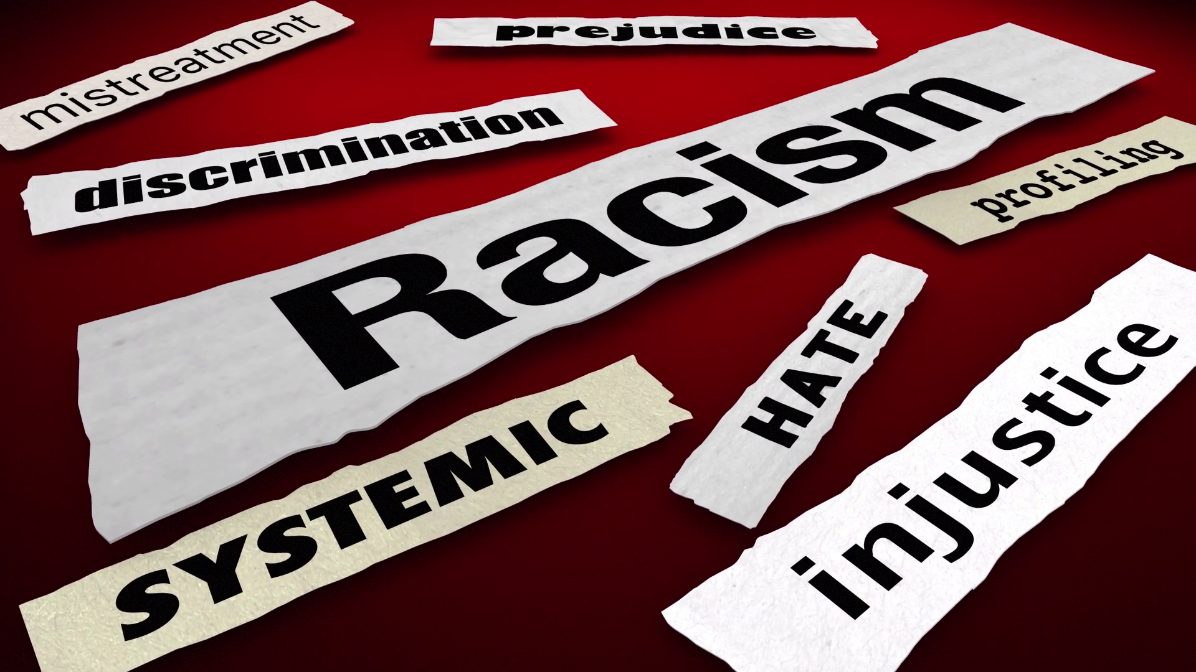
Systemic inequality is a form of racism this is embedded in the culture, laws and regulations of a society.
Interpersonal Racism
Structural Racism
Institutional Racism
Individual Racism
Internalized Racism
Notes:
Racism is what makes us see the “other” with suspicion or to attribute negative characteristics to an entire group of people.
It manifests itself in our individual thoughts and then in the workings of our society itself.
Today’s continuing inequalities in education, housing, employment, wealth and representation in leadership positions are rooted in our country’s history of slavery and systemic racism.
In the legal system, structural barriers are present in the oft-cited racial disparities in mandatory minimum sentencing rules for drug use, and in targeting predominantly Black, low-income communities for nonviolent drug crimes whose punishment can escalate into a loss of voting rights and other freedoms.
Internalized Racism: A set of privately held beliefs, prejudices and ideas about the superiority of whites and the inferiority of people of color. Among people of color, it manifests as internalized oppression. Among whites, it manifests as internalized racial superiority.
Interpersonal Racism: The expression of racism between individuals. It occurs when individuals interact and their private beliefs affect their interactions.
Institutional Racism: Discriminatory treatment, unfair policies and practices, and inequitable opportunities and impacts within organizations and institutions, all based on race, that routinely produce racially inequitable outcomes for people of color and advantages for white people. Individuals within institutions take on the power of the institution when they reinforce racial inequities.
Structural Racism: A system in which public policies, institutional practices, cultural representations and other norms work in various, often reinforcing, ways to perpetuate racial group inequality. It is racial bias among institutions and across society. It involves the cumulative and compounding effects of societal factors including the history, culture, ideology and interactions of institutions and policies that systematically privilege white people and disadvantage people of color.
Implicit or unconscious bias refers to stereotypes, attitudes or beliefs that affect our understanding, actions and decisions in an unconscious way. These biases, which may be favorable or unfavorable, cause us to have feelings and attitudes about people based on characteristics such as race, ethnicity, gender or gender identity, age or appearance. These develop over the course of a lifetime beginning early in life through exposure to direct and indirect messages.
They are pervasive. Everyone has them.
They don’t necessarily align with professed beliefs.
They are generally favorable to our own “in-group.”
They are malleable, i.e., they can be unlearned.
Much of the problem is that racial biases not only occur in individuals, but are also embedded in our institutions—what sociologists refer to as “structural” or “systemic” racism. Once primarily heard among social scientists, these terms have, in the past few months, become more mainstream. Systemic racism refers to the well documented fact that most of our institutions—in politics, law, education, and health care, to name a few—are fundamentally organized according to assumptions and policies that work to the disadvantage of communities of color, and Blacks in particular.
In health care, for instance, this can mean pay policies that discourage practitioners from treating patients who are affected by poverty, discrimination, and other factors that can impair health—factors that disproportionately affect Black patients and the Black practitioners who are more likely to treat them.
Racism disproportionately shapes the environment and life experiences of Black, Hispanic/Latinx, Asian, Pacific Islander, Native American, and other racially oppressed and disenfranchised people (hereinafter collectively referred to as Black, Indigenous, People of Color (BIPOC),.
It adversely influences both their risk of developing addiction and their access to evidence-based (prevention and) treatment services.
While police and civilian murders of Black people in the United States of America have highlighted the deadly consequences of racism, they have also illuminated the impact of the long-standing systemic racism in the United States.
Systemic racism has been defined as “a system in which public policies, institutional practices, cultural representations, and other norms work in various, often reinforcing ways to perpetuate racial group inequity.” (ASAM, 2012)

Slide 7
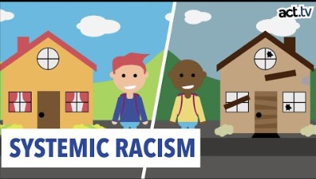

Slide 8
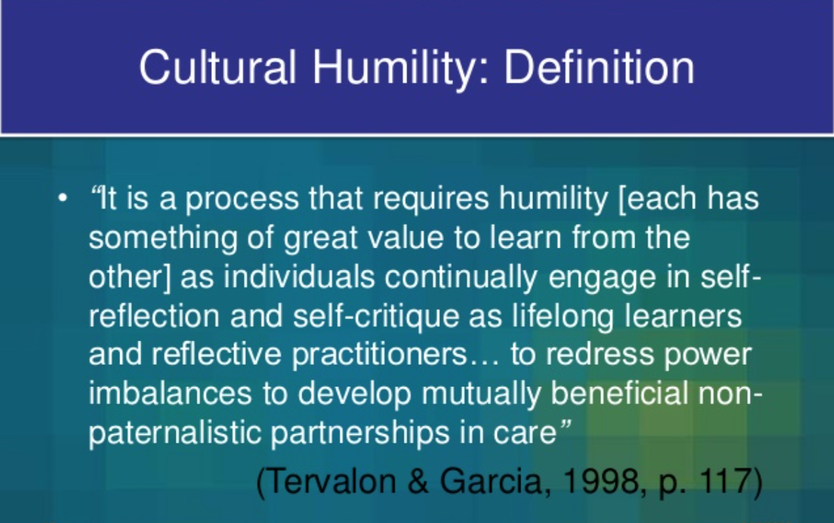

Slide 9

Cultural and linguistic competence is a set of congruent behaviors, attitudes, and policies that come together in a system, agency, or among professionals that enables effective work in cross-cultural situations.
‘Culture’ refers to integrated patterns of human behavior that include the language, thoughts, communications, actions, customs, beliefs, values, and institutions of racial, ethnic, religious, or social groups.
‘Competence’ implies having the capacity to function effectively as an individual and an organization within the context of the cultural beliefs, behaviors, and needs presented by consumers and their communities.
Office of Minority Health, 2000

Slide 10
Prevention Across the Decades: The Early Years
 | SUBSTANCE MISUSE HISTORY | PREVENTION STRATEGY | ATTENTION TO HEALTH EQUITY
1950s & 1960s | Drug misuse intensifies. Heroin use high in urban areas. Psychedelic drugs widely used. Misuse associated with counter culture and minorities. | Scare Tactics through films and speakers One time presentations on process of getting addicted | None Grants given to groups offering what was perceived to be the best ideas. Needs assessment never done.
1970s | 20% of Block Grant to prevention Substance misuse seen as national problem. Controlled Substance Act “War on Drugs” Increasing tolerance of certain drug use | .Focus on providing drug information, some alternative programs Affective education | None Grants given to groups offering what was perceived to be the best ideas. Needs assessment never done.
Notes:
“Addiction is the interaction of multiple factors, each of which can be influenced by systemic racism. The factors that lead to an individual’s substance use disorder stem from their genetics, their environment and their life experiences. And when it comes to the environment and an individual’s life experiences, racism disproportionately shapes the lives of Black, Indigenous and other people of color,” said Dr. Stephen M. Taylor, an Alabama-based specialist who helped the American Society of Addiction Medicine. “The Anti-Drug Abuse Act of 1986 enacted a 100-fold greater sentencing disparity for water-insoluble cocaine base – “crack” – used in Black communities and powder cocaine favored in white ones,” Taylor said. (ASAM, 2021)
In the 2000s, the response to opioid misuse, which was more identified with whites, was compassion, research, treatment and prevention. Says Taylor: “National survey data … suggests that BIPOC individuals and white individuals use drugs and sell drugs at similar rates. Yet BIPOC individuals are about more than two-and-a-half times more likely to be arrested for drug use or drug selling activity, and more than six times more likely to be incarcerated for that activity.”

Slide 11
Prevention Across the Decades: The Middle Years
 | SUBSTANCE MISUSE HISTORY | PREVENTION STRATEGY | ATTENTION TO HEALTH EQUITY
1980s | Partnerships develop as public gets involved in prevention Crack cocaine devastates the Black community. Punishment for crack use much harsher than for cocaine powder use. Suicides & homicides among Black men double. Hip hop music promotes drug use. | “Just Say NO” Parent groups formed Life skills and refusal skills curricula Parenting education DARE a required prevention program Risk and Protective Factor Theory introduced by Hawkins and Catalano | None Grants given to groups offering what was perceived to be the best ideas. Needs assessment never done. Cultural competency training offered
1990s | Professionalism ( IC&RC) & training grows. Community collaborations funded Focus on implementing EBIs Promotion of opioids by Big Pharma First wave: Opioid deaths involving prescription opioids | DARE defunded Environmental approaches Culturally specific programs developed Evaluation required NREPP established SAPST developed by Western CAPT Strategic Prevention Framework (SPF) introduced | Needs assessments identified populations most in need Cultural Competence at center of the SPF Coalitions often overlooked focus populations in their planning (Do for, not with) Focus on EBIs, not necessarily culturally appropriate

Slide 12
Prevention Across the Decades: The 21st Century
 | SUBSTANCE MISUSE HISTORY | PREVENTION STRATEGIES | ATTENTION TO HEALTH EQUITY
2000s | Understanding of connections between SUDs and mental illness increased. Opioid epidemic continued with rapid increases in deaths due to synthetic opioids | Application of EBIs, targeting many contexts SPF planning process required. SAPST revised as SAMHSA product Emphasis on universal interventions | Needs assessments identified populations most in need. Cultural Competence at center of SPF. Coalitions often overlooked including focus population in planning. Funds focused on use of EBIs, not always culturally appropriate interventions.
2010-present | ACA Act of 2010 integrated behavioral health with primary care with better benefits for mental health and substance abuse treatment. CO and WA became first states to legalize recreational use of cannabis. NREPP eliminated. | Continued emphasis on EBIs, SPF SAPST revised (2013, 2018). Pacific Island version created. | 2018 SAPST adds slides on health equity. Emphasis on including focus populations in all steps of planning: “Nothing About Us Without Us.” Service providers remain predominantly female and white.

Slide 13
Is Racial Discrimination a Risk Factor?
“Results across two studies using different methods converge in suggesting that perceived racial discrimination has an important impact on the mental health and substance use habits of some African Americans. Those effects can be seen in adolescents as young as 13 and in their parents, and the pattern is similar for both: Discrimination leads to anger and hostility, and for some, that affect translates into willingness to use substances and then to actual use. It is the case, however, that these negative effects of discrimination in adolescents can be countered somewhat by supportive parenting from their parents.”
(Gibbons et al. 2012)
Notes:
Frederick X. Gibbons, Paul E. Etcheverry, Michelle L. Stock, Meg Gerrard, Chih-Yuan Weng, Marc Kiviniemi, and Ross O'Hara (2012), “Exploring the Link between Racial Discrimination and Substance Use: What Mediates? What Buffers?”
Journal of Personality and Social Psychology

Slide 14
Systemic Failures of Public Health
Not considering culture first
Not acknowledging the focus community’s expertise on what is needed most in their communities and so not including them in all the steps of the planning process
Not acknowledging and appreciating the value of the protective factors and indigenous interventions that exist in a community
Not respecting the autonomy of communities to select interventions that are appealing and consistent with the values of their culture
Assuming that the values and methods of the dominant culture are superior to all others
Others?

Slide 15

Notes:
As you watch this video, think of the ways in which drug policies have disproportionately impacted people of color.

Slide 16
The Result: Drug Policies Reflecting Systemic Inequality
De-medicalization of addiction – policing over public health (1914 Harrison Narcotics Act)
Criminal legal reform failures (1980s)
Selective and discriminatory recognition of addiction as a medical condition, e.g., crack versus cocaine (1980s, 1990s)
Inequitable expansion of treatment (Drug Abuse Treatment Act 2020)
Sales restrictions placed on flavored tobacco products except for those featuring menthol (2020)
Focus on EBIs without consideration of cultural differences
Notes:
The impact of systemic racism in drug policy and addiction medicine is evident in:
● De-medicalization (from medicalization to criminalization): Addiction medicine is older than criminalization, but this initial era ended with the passage of the 1914 Harrison Narcotic Tax Act (Ch. 1 38 Stat 785) (HNTA). The passage of the HNTA as well as its enforcement was dominated by explicit racism directed against immigrant Asian and Hispanic/Latinx labor, Black men and concern about women stolen into “white slavery” – and it ushered in a period that prioritized policing over public health.
● Criminal legal reform failures: Mandatory sentencing guidelines, codified in the 1984 Sentencing Reform Act, were intended to address racial inequities in the criminal legal system. However, unguided discretion at the local and prosecutorial level worsened inequities primarily through guilty pleas rather than judicial action. Systemic racism in drug policy is perhaps most easily recognized in the Anti-Drug Abuse Act of 1986, which enacted a 100-fold greater sentencing disparity for water-insoluble cocaine base (“crack”) versus powder cocaine.
● Selective and discriminatory recognition of addiction as a medical condition: The federal and state response to crack use in the 1980s and 1990s focused funding on law enforcement, which was then targeted at BIPOC. Conversely, three-quarters of federal funding to address the opioid epidemic, associated more closely with white people, went to research, treatment, and prevention. Media portrayals of drug policy has supported systemic racism. Drug controls arose from a mix of motives, some of which were laudable, but many of which were based in racist ideology. Racial bias has emerged in policies as written and applied. Black and Hispanic/Latinx people who use heroin as criminals and white people who use prescription opioids as sympathetic victims reinforced the racialized policy response to drug use.
● Inequitable expansion of treatment: Motivated, in part, by an association of the opioid crisis with white people and in response to the historic location of addiction treatment with the criminal legal system, the Drug Addiction Treatment Act of 2000 (DATA 2000) was enacted to expand care in the medical setting. However, the benefit of expanded treatment has been unequal. Opioid use disorder (OUD) treatment remains segregated, with Black and Hispanic/Latinx people more likely to receive methadone, which is only available in highly regulated systems, and white people more likely than people of other races to receive buprenorphine, which is available in an office- based setting.
● Beyond the multiple problems with the treatment of OUD, continues in other ways: In 2020, sales restrictions were placed on flavored tobacco products except for those featuring menthol, the product most often used by Black people. In essence, this prioritized tobacco company profits over the health of Black people. In addition, alcohol outlet density remains far greater in Black and Hispanic/Latinx neighborhoods. Some have argued that this fact reflects structural racism in the built environment.

Slide 17
The Impact on Prevention Services
Lack of focus on evidence-based SUD prevention research among BIPOC
Lack of access to secondary prevention interventions such as overdose education and naloxone distribution programs within BIPOC communities
Lower availability of evidence-based programs for BIPOC
Underrepresentation of BIPOC in scientific studies, thus yielding interventions that may not be culturally appropriate
Markedly different rates of incarceration despite national data that suggest that BIPOC and whites use drugs at similar rates
Others?
Notes:
The contemporary consequence of this racist history is seen in:
● The lack of focus on evidence-based SUD prevention research among BIPOC and lack of access to secondary prevention interventions such as overdose education and naloxone distribution programs within BIPOC communities;
● The lower availability of evidence-based treatment (particularly buprenorphine) for BIPOC and the continued experience of discrimination within treatment programs and systems; 22
● The unequal deployment of drug testing with markedly different consequences for BIPOC when their test results are positive; 23,
● The underrepresentation of BIPOC in scientific studies, thus yielding interventions that may not be culturally appropriate;
● Markedly different rates of incarceration despite national survey data that suggest that BIPOC and whites use drugs at similar rates.. The overcriminalization of drug use by BIPOC and disparate policing of BIPOC who use drugs is well documented. The effects of this discrimination are devastating and lasting

Slide 18
One Problem: Adapting EBIs to Non-Dominant Cultures
Lack of fit between research-based interventions and the community’s capacity to implement them
Lack of appeal to consumers when they don’t reflect their culture, values and preferences
Lack of fidelity in implementation
Lack of confidence in the efficacy data when the research was conducted with a different population
(Sandler el al, 2005)

Slide 19
Reviewing Our Policies
Examine our own motivations, biases, and practices related to BIPOC to deliver equitable, compassionate, and anti-racism-informed services
Lead practices that acknowledge and respond to participants’ experiences of structural racism
Review prevention programs and practices to identify gaps related to cultural understanding
Advocate for policies that lead to a more diverse workforce and seek opportunities to mentor BIPOC into the prevention field
Notes:
The American Society of Addiction Medicine in its 2021 Policy Statement recommends:
Addiction medicine professionals should examine their own motivations, biases, and practices related to BIPOC to deliver equitable, compassionate, and anti-racism-informed medical care to all patients. Research is needed to identify best practices for motivating and facilitating such an examination.
Addiction medicine professionals must lead medical practices and treatment programs that acknowledge and respond to patients’ experiences of racism by
(a) trusting and respecting patients’ experiences through trauma-informed care,
(b) assessing patients for social determinants of health, including those that are linked to racism, and connecting them with community resources, and
(c) evaluating their medical practices based on staff diversity and BIPOC patient satisfaction and retention in treatment.
Addiction medicine professionals should develop proficiency in practice, and demonstrate leadership in trauma-informed care as well as structural competency, so that they can
(a) understand participant experiences in the context of structural factors that influence their health;
(b) intervene to address those structural factors, such as inequalities in law enforcement, housing, education, access to health care, and other resources, that put people of color at risk for unhealthy substance use and addiction or limit their access to prevention, treatment and recovery supports; and
(c) collaborate with community leaders and health professionals with humility and patience.
Providers of addiction medicine training in medical school, residency, fellowship and continuing medical education (CME) programs should review their curricula to identify gaps related to trauma-informed care, structural competency, and racial understanding. Clinical educators should develop and promote training courses grounded in trauma-informed care and structural competency to improve the outcomes of patients who are socially marginalized by virtue of their race, e.g., those who are identified more frequently by the criminal legal system due to disparate policing and then are referred or mandated to addiction treatment.
Addiction medicine professionals should advocate for policies that lead to a more diverse addiction treatment workforce and should seek opportunities to mentor BIPOC clinicians into the field. Robust funding should be made available and targeted for scholarships and loan repayment for BIPOC addiction medicine professionals.
Addiction medicine professionals should advocate for policies that ensure BIPOC at risk of, or with, addiction have equitable access to evidence-based prevention, early intervention, treatment, and harm reduction services. Further, addiction medicine professionals should advocate for policies that are designed to eliminate structural inequalities in social and economic factors that influence substance use and addiction (e.g., law enforcement practices and access to housing, education, and health care), as these social determinants of health contribute to health disparities between BIPOC and white people.
Addiction-related research should strive to include an equitable representation of BIPOC researchers and participants in study design, implementation, and dissemination of results. Addiction-related research should evaluate the impact of systemic racism on drug use; risk and protective factors for addiction; and access to prevention interventions, treatment and harm reduction options, and recovery support services. Clinical resources and recommendations should be designed with consideration of the broad social, political, and economic structures that affect health and illness. Community-based participatory research methods can help build trust between researchers and BIPOC given historical research practices.
Adopted by the ASAM Board of Directors February 25, 2021. © Copyright 2021. American Society of Addiction Medicine, Inc. All rights reserved. Permission to make digital or hard copies of this work for personal or classroom use is granted without fee provided that copies are not made or distributed for commercial, advertising or promotional purposes, and that copies bear this notice and the full citation

Slide 20
Reviewing Our Policies
Include an equitable representation of BIPOC researchers and participants in study designs
Support local prevention programs that are culturally appropriate, comprehensive, holistic, accessible and community controlled
Make a concerted effort to recruit and train BIPOC to work in prevention
Advocate for fair pay commensurate with the skill set of a prevention professional
Others?

Slide 21

What Should We Do? A Personal Action Plan
What can you do in the next six months as a prevention leader to effect change in a system that, advertently or inadvertently, promotes systemic inequality?

Slide 22

Implement “Two Eyed Seeing”
Learning to see from one eye with the strengths of Indigenous knowledges and ways of knowing, and from the other eye with the strengths of mainstream knowledges and ways of knowing, and to use both these eyes together, for the benefit of all.
Mi’kmaq Elders, Albert, and Murdena Marshall, Unama’ki (Cape Breton), Nova Scotia, Canada, 2004.
Notes:
Two-Eyed Seeing provides the gift of multiple perspectives. “It encourages the realization that beneficial outcomes are much more likely in any given situation when we are willing to bring two or more perspectives into play,” writes Mi’kmaq Elder Albert Marshall
The advantage of Two-Eyed Seeing is that you are always fine tuning your mind into different places at once, you are always looking for another perspective and better way of doing things.”

Slide 23

Being Instruments of Change
Notes:
What is badly needed is a wider range of perspectives. This suggestion may not sit well with some researchers who are committed to the belief that theirs is a completely meritocratic field where power is held by those selected according to merit like degrees or status in the field. But bringing together a broader variety of voices to the prevention community will help all of us as they continue to make discoveries about what works and promotes wellness. (Barrera et al, 2011)
In closing, I would like to borrow a line from “Just Mercy ” a movie about the wrongful conviction of a black man in AL in the 1990’s. In it, the young attorney, Bryan Stevenson says, “Hopelessness is the enemy of justice.” Systemic inequality remains a force in our culture though we have made progress. As people and prevention professionals who are committed to “creating conditions that support the well-being of individuals, families and communities,” we must not only be hopeful about the possibility of systemic equity but also be advocates for justice and equity in our communities and in our prevention work, its programs, practices and policies. It is our professional and ethical responsibility to do so.

Slide 24


Slide 25
References
American Society of Addiction Medicine (2012) Public Policy Statement on Advancing Racial Justice in Addiction Medicine in https://www.asam.org/docs/default-source/public-policy-statements/asam-policy-statement-on-racial-justiced7a33a9472bc604ca5b7ff000030b21a.pdf?sfvrsn=5a1f5ac2_2
Black History Milestones (2021) in History.com
Barrera, M, Castro, F, & Steiker, L ((2011) “A critical Analysis of Approaches to the Development of Preventive Interventions for Subcultural Groups. Am J of Community Psychology in https://www.researchgate.net/profile/Felipe-Castro-2/publication/49726615 A_Critical_Analysis_of_Approaches_to_the_Development_of_Preventive_Interventions_forSubcultural_Groups/links/6043e1ba299bf1e0785f6139/A-Critical-Analysis-of-Approaches-to-the-Development-of-Preventive-Interventions-for-Subcultural-Groups.pdf
Gibbons, F, Etcheverry, P, Stock, M, Gerrard, M;Wang, C.Y, Kivinlemi. M & O’Hara, R.(2012) Exploring the Link between Racial Discrimination and Substance Use: What Mediates? What Buffers? In Journal of Personality and Social Psychology, and https://www.ncbihttps://www.ncbi.nlm.nih.gov/pmc/articles/PMC3314492
Racial Equity Tools in racial equity,org
SAMHSA (2014) TIP 59: Improving Cultural Competence in https://store.samhsa.gov/sites/default/files/d7/priv/sma14-4849.pdf
Sandler, I. N., Ostrom, A., Bitner, M. J., Ayers, T. S., Wolchik, S. A., & Daniels, V. S. (2005). Developing effective prevention services for the real world: A Prevention Service Development Model. American Journal of Community Psychology, 35, 127–142.

