Slide 1
The prevention Professional
Improving Our Competencies
Sandra P. Del Sesto, M.Ed, ACPS
Copyright 2023

Slide 2

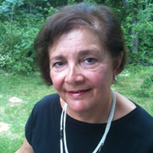

PRESENTER
Sandra Del Sesto is a co-author of the SPF Application for Prevention Specialist Training (SAPST) and the required Prevention Ethics course. For over 35 years, she has provided community and strategic planning, program development, and capacity building in all areas of prevention practice. Currently, she serves on the advisory boards of the National Prevention Technology Transfer Center (PTTC), the New England PTTC, and the former Latino PTTC. She has been a RI delegate to the International Certification and Reciprocity Consortium and past co-chair of its Prevention Committee.
Insert Headshot
Sandra Del Sesto, M.ED, ACPS
Prevention Solutions Consultant
2
PREVENTION SOLUTIONS@EDC Professionalism in Prevention

Slide 3

Tell us about you…
Name and State You Work In
Years in Prevention
Your Prevention Title
How You Describe Yourself as a Prevention Professional

Slide 4
Objectives
Define profession
Explain why prevention is a true profession
Describe what it means to be a prevention professional
Discuss how we represent our organizations in a professional manner
Identify steps to improve our professional skills
PREVENTION SOLUTIONS@EDC Professionalism in Prevention

Slide 5
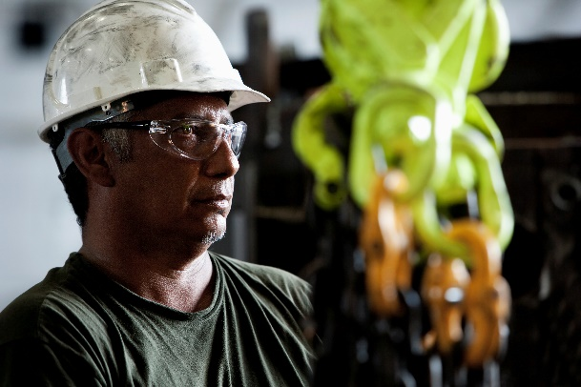





What Is a Profession?
PREVENTION SOLUTIONS@EDC Professionalism in Prevention
Notes:
Let’s begin our conversation by defining what a profession really is,

Slide 6
Characteristics of a Profession
A profession becomes a full-time occupation.
Competencies are identified for a profession.
Education/training institutions are established.
Local/national associations are established.
State licensing laws/certification regulations are established.
PREVENTION IS A PROFESSION!
PREVENTION SOLUTIONS@EDC Professionalism in Prevention
Notes:
Prevention meets all these criteria.

Slide 7

Prevention as a Regulated Profession
There are two basic tenets for regulation:
There is a level of risk to the public.
There is a specific body of knowledge which requires competency by the professional.
Prevention meets both of these identifiers.
PREVENTION SOLUTIONS@EDC Professionalism in Prevention

Slide 8
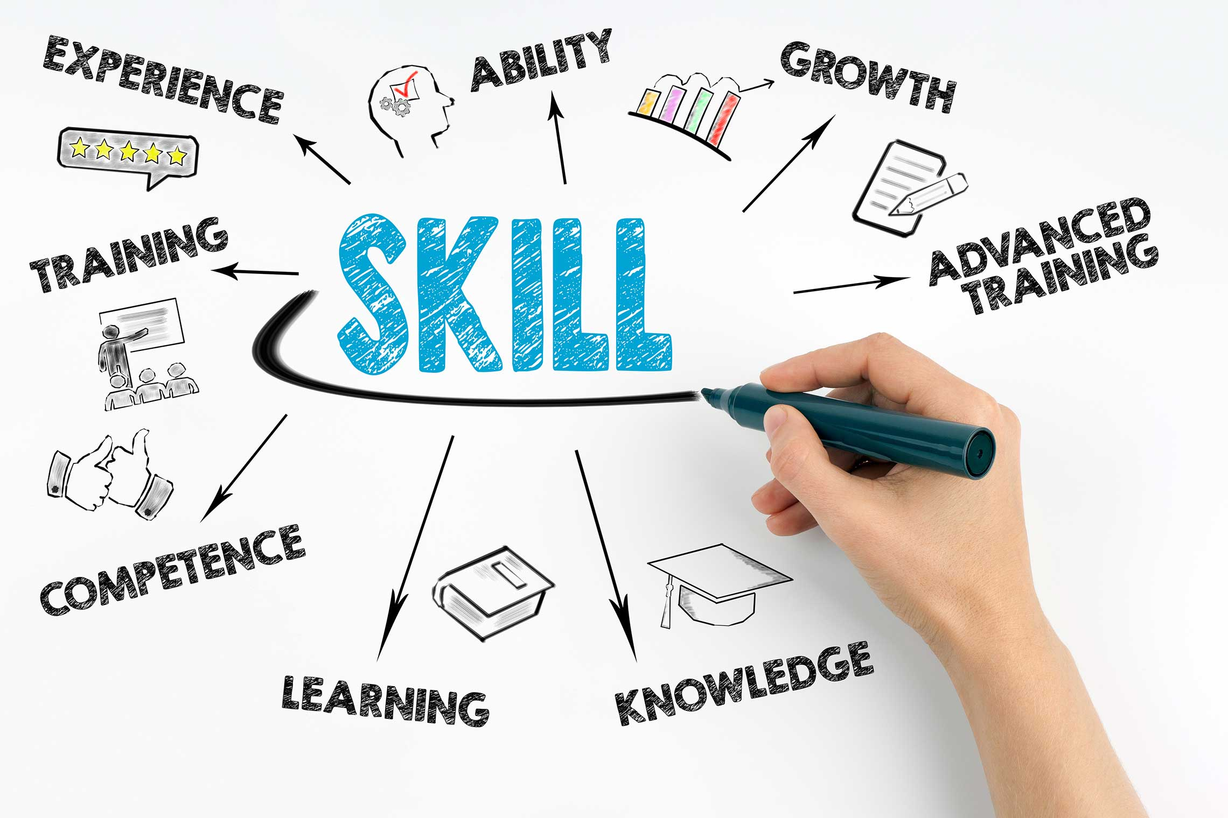
Professional Competency
In a profession competency must be measured and monitored – we cannot assume that someone is competent.
PREVENTION SOLUTIONS@EDC Professionalism in Prevention
Notes:
All professions measure and monitor competency: medicine, psychology, social work, law, etc.

Slide 9

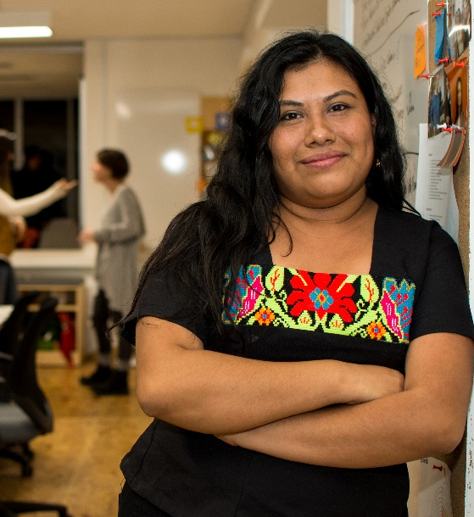



What Is a Prevention Professional?
PREVENTION SOLUTIONS@EDC Professionalism in Prevention

Slide 10
In General, Any Professional Is a Person Who…
Is a member of a professional body due to the education qualifications and follows the prescribed values and professional code of conduct.
Has mastered a high level of expertise in a subject or field.
PREVENTION SOLUTIONS@EDC Professionalism in Prevention

Slide 11

How Would You Describe a Professional?
PREVENTION SOLUTIONS@EDC Professionalism in Prevention
Notes:
Ask the Question: How Would You Describe a Professional? Have the participants write down three words they would use.
Introduce the video and ask them to see if their words were listed by the people in the video and also which words in the video they would add to their list.
Show the video. https://www.youtube.com/watch?v=2vFdQY1qSlM
Ask participants to share
the words that were both on their list and on the video.
then any words were offered in the video that were not on their list
finally, any words that were on their list but not in the video.
Summarize.

Slide 12
Personal Characteristics of a Professional
Ethical
Reliable
Organized
Respectful of others
Accountable
Positive attitude
Emotional control
Calm under pressure
PREVENTION SOLUTIONS@EDC Professionalism in Prevention
Notes:
INDEED, the job search, offers this list of characteristics of a professional:
Respectful of others
Professionals always treat others with respect. They understand that though humor is appropriate in the workplace, they should always use it with respect to others. The only time that professionals engage in conversations about other people is if they are evaluating their performance and looking for constructive ways to improve their performance in the workplace.
Ethical
Embodying professionalism also means to be committed to doing the right thing. Honesty, open disclosure and sincerity are all characteristics of ethical behavior. Many organizations include a commitment to ethical behavior in their code of conduct. Professionals can adopt a personal code of conduct and make the same commitment on an individual basis. Related: Professional Code of Ethics
Reliable
Professionals are dependable and keep their commitments. They do what they say they will do and don't overpromise. Professionals respond to colleagues and customers promptly and follow through on their commitments in a timely manner. Punctuality is a key aspect of this professional characteristic. It's always important to clarify any areas of uncertainty when dealing with customers or members of your team to ensure there are no mistaken assumptions or surprises.
A professional keeps their workspace neat and organized so that they can easily find items when they need them. All files and paperwork should be in place and, if they have to deliver a presentation, all materials should be ready well in advance so there are no unexpected delays.
Organized
Accountable
Just as a professional accepts credit for having completed a task or achieved a goal, they also are accountable for their actions when they fail. They take responsibility for any mistakes that they make and take whatever steps necessary to resolve any consequences from mistakes. They are accountable and expect accountability from others.
Positive attitude
Part of being a professional means maintaining a positive, can-do attitude while working. A positive attitude will improve a professional's overall performance and increase the likelihood of a positive outcome. It will also impact the behavior and performance of others, improving employee morale in the office.
Emotional control
Emotional control is another key characteristic of professionalism. Professionals understand the importance of maintaining their composure and staying calm in all situations. By remaining calm, even during challenging moments, others can rely on them to be rational and of sound judgment.
12. Poised
Professionals should demonstrate poise, a calm and confident state of being. Being poised means maintaining a straight posture, making eye contact when communicating and helping establish a friendly and professional presence. Being poised means also staying calm during times of heightened pressure.

Slide 13
Other Essential Characteristics of a Professional
Professional appearance and language
Goal focused
Effective time management
Ability to separate the personal from the professional
Strong communicator
Multiple “soft” skills
PREVENTION SOLUTIONS@EDC Professionalism in Prevention
Notes:
15 Characteristics of Professionals By Jennifer Herrity Updated June 9, 2021 | Published April 3, 2020 in https://www.indeed.com/career-advice/career-development/professional-characteristics
Professional appearance
Professionals should always strive for a professional appearance, including appropriate attire and proper hygiene and grooming
Professional language
People who behave with professionalism monitor every area of their behavior, including how they talk. They minimize the use of slang and avoid using inappropriate language in the workplace. They even are conscientious of the language they use in informal settings.
Goal Focused
A professional is clear about their goals and understands what they need to accomplish to achieve them. They know how to stay focused on their work to maintain their productivity. Professionals recognize the importance of maintaining focus to improve the quality of their work and be as efficient as possible.
Effective time management
An employee who knows how to manage their time well is viewed by their peers as a professional. Some characteristics of time management abilities include showing up at the office on time in the morning, being on time for meetings and letting someone in the office know if they suspect that they might be late.
Separates personal and professional
Professionals understand the importance of separating their personal lives from their professional lives. While professionals may experience the same challenges in their personal lives as others, they maintain a clear separation between their professional lives and workplace demeanor.
Strong communicator
A professional must have strong communication skills. This means that they not only can effectively and efficiently convey messages to others but also that they can actively listen to and understand what others are telling them. By engaging in open and constructive communication with others, professionals can collaborate more effectively and accomplish a lot.
Possesses soft skills
Soft skills are personal attributes that allow someone to interact effectively with others. Soft skills include things like leadership, critical thinking, teamwork and people skills. Soft skills help professionals to behave courteously when addressing colleagues and managers, use the right language when communicating and respect the opinions of others.

Slide 14
Of the Characteristics Mentioned…
Which of these am I best at?
Which of these could I improve upon?
Selecting two from #2 above, what are two concrete steps I could take in the next three months to improve that characteristic?
PREVENTION SOLUTIONS@EDC Professionalism in Prevention
Notes:
Ask a few participants t share one characteristic for items 1 and 2 and then one action step,
Comment that we must always be growing as a professional and the only way to do that is to always have a personal growth plan.

Slide 15
The Certified
Prevention Specialist
Established by the International Certification and Reciprocity Consortium in 1994.
Sets standards for education/training, supervision and experience
Develops and administers an international examination to measure prevention competencies
Requires six hours of prevention ethics training
Designates state/jurisdiction certification boards to oversee the certification process ( 48 currently)
Provides an international prevention specialist certification
PREVENTION SOLUTIONS@EDC Professionalism in Prevention

Slide 16
Basic Competency Areas of a Prevention Professional: IC&RC
Domain | Percent
Planning and Evaluation | 30%*
Prevention Education and Service Delivery | 14%
Communication | 13%
Community Organization | 15%
Public Policy and Environmental Change | 12%
Professional Growth and Responsibility | 15%
PREVENTION SOLUTIONS@EDC Professionalism in Prevention

Slide 17

Prevention Code of Ethics: Six Principles
Non-discrimination
Competence
Integrity
Nature of Services
Confidentiality
Ethical Obligation for Community and Society
PREVENTION SOLUTIONS@EDC Professionalism in Prevention

Slide 18
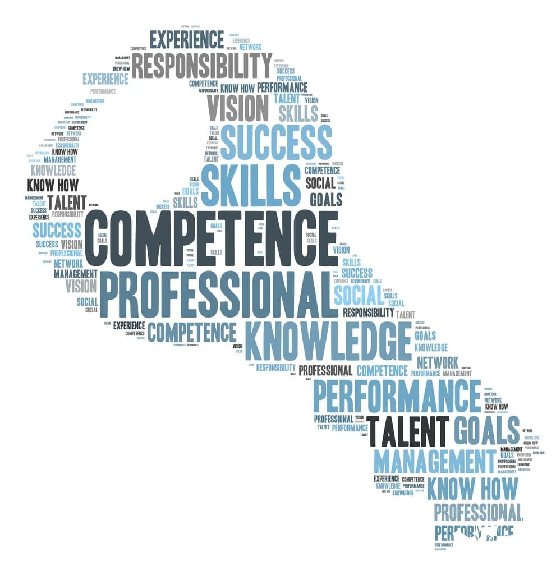
Samhsa’s core competencies

Slide 19
Prevention core competencies: cross cutting
Interdisciplinary Foundations (Substance Use Disorders and Mental Health) . . . . . . . . . . . . . . . . . . . . . . . . . .
Role of Multiple Systems and Systems Thinking . . . . . . . . . . . . . . . . . . . . . .
Family Dynamics . . . . . . . . . . . . . . . . . . . . . . . . . . . . . . . . . . . . . . . . . . . . .
Ethical Practice and Professional Responsibility . . . . . . . . . . . . . . . . . . . . . .
Basic Knowledge . . . . . . . . . . . . . . . . . . . . . . . . . . . . . . . . . . . . . . . . . . . .
Communication . . . . . . . . . . . . . . . . . . . . . . . . . . . . . . . . . . . . . . . . . . . . . .

Slide 20
Assessment / capacity
Data Gathering . . . . . . . . . . . . . . . . . . . . . . . . . . . . . . . . . . . . . . . . . . . . . .
Needs and Resource Identification . . . . . . . . . . . . . . . . . . . . . . . . . . . . . . . .
Problem Definition . . . . . . . . . . . . . . . . . . . . . . . . . . . . . . . . . . . . . . . . . . . .
Analysis . . . . . . . . . . . . . . . . . . . . . . . . . . . . . . . . . . . . . . . . . . . . . . . . . . .
Collaboration . . . . . . . . . . . . . . . . . . . . . . . . . . . . . . . . . . . . . . . . . . . . . . . .
Organizational Advocacy . . . . . . . . . . . . . . . . . . . . . . . . . . . . . . . . . . . . . . .
Organizational Cultural Proficiency . . . . . . . . . . . . . . . . . . . . . . . . . . . . . . . .

Slide 21
Planning
Collaborative Planning . . . . . . . . . . . . . . . . . . . . . . . . . . . . . . . . . . . . . . . . .
Cultural Inclusion . . . . . . . . . . . . . . . . . . . . . . . . . . . . . . . . . . . . . . . . . . . . .
Systematic Thinking . . . . . . . . . . . . . . . . . . . . . . . . . . . . . . . . . . . . . . . . . .
Evidence-Informed Approaches . . . . . . . . . . . . . . . . . . . . . . . . . . . . . . . . . .
Facilitation . . . . . . . . . . . . . . . . . . . . . . . . . . . . . . . . . . . . . . . . . . . . . . . . . .
Strategic Planning . . . . . . . . . . . . . . . . . . . . . . . . . . . . . . . . . . . . . . . . . . . .
. . . . . . . . .

Slide 22
Implementation / Evaluation
Cultural Responsiveness . . . . . . . . . . . . . . . . . . . . . . . . . . . . . . . . . . . . . . .
Collaboration . . . . . . . . . . . . . . . . . . . . . . . . . . . . . . . . . . . . . . . . . . . . . . . .
Change Management . . . . . . . . . . . . . . . . . . . . . . . . . . . . . . . . . . . . . . . . .
Evaluation Methods . . . . . . . . . . . . . . . . . . . . . . . . . . . . . . . . . . . . . . . . . . .
Data Interpretation and Use . . . . . . . . . . . . . . . . . . . . . . . . . . . . . . . . . . . . .

Slide 23

How Do we represent Our organizations?
PREVENTION SOLUTIONS@EDC Professionalism in Prevention
Notes:
How do we inspire our staff and our coalition representatives to present ourselves as professionals?
How does this pertain to the youth who represent us?

Slide 24
Professional Organizations
Professional organizations are formed to:
Further the interests of people in a particular profession and advance a particular profession
Fulfill a specific mission and vision
Serve the public good
Embody integrity, legality, and fiscal accountability
Provide culturally proficient services that reduce risk factors and enhance protective factors through a strategic community-based planning process
PREVENTION SOLUTIONS@EDC Professionalism in Prevention
Notes:
Professional organizations have this. As a prevention professional, it is your responsibility to represent your organization in this way whether it is your agency or your coalition.
Integrity: “Honorable behavior,” fair and accurate services, strong moral principles, respect…personal principles elevated to
Legality: contract compliance, adherence to all laws
Fiscal accountability:

Slide 25

Representing Your Organization Professionally
Be prepared to articulate your mission.
Be always constituent centered.
Aim to ensure equity.
Focus on mobilizing and inspiring others.
PREVENTION SOLUTIONS@EDC Professionalism in Prevention
Notes:
Mission:-focused Clearly articulates its mission shares it with staff and constituents, and stays on its mission pathway
Constituent centered: staff, partners, service recipients, funders, community, It is essential that organizations communicate with all its constituents about how THRY made things happen and contributed to the success of its activities and mission.
Diversified in funding, To sustain the organization and actualize its mission,, organizations must be creative in identifying funding related to its mission: grants, fees, inkind, fund-raising.
by building strong relationships, inspire others to take action, la by example, provide others with opportunities to engage in its cause. This happens only when we work Mobilize and inspire with others to create conversations and influence policies that effect positive change.
Agile: It needs to continually respond t change and unexpected risks.
Digitally savvy: Technology is transforming how we communicate and provide services. We need to develop the expertise to stay current with technology at all levels of the organization to stay relevant
Listens and improves: Listens to constituents all all levels,, including those who constitute the “loyal opposition.” We must bring enthusiasm, a passion for growth and positive change, and a willingness to take on the challenges that prevention constantly presents.

Slide 26

Grow as a Professional
Dream: Describe where you want to be in 3-5 years.
Look: Search for new opportunities and take professional risks.
Seek: Find mentors or a coach.
Grow: Expand your network.
PREVENTION SOLUTIONS@EDC Professionalism in Prevention
Notes:
QUESTIONS FOR PARTICIPANTS:
(Tell my goal setting story)
It’s 2023, a time for New Year’s Goals: Have you set at least three professional goals for this year? (Harvard study: set goals but don’t share them---Write down goals----write down and share goals. Who would you share your goals with?
What is a risk you are willing to take this year? Take the prevention exam? Learn a new skill and try it out a new skill? Are you willing to be uncomfortable for a while?
How did you find your mentors?
How have you grown your network?

Slide 27

Action Steps for Growth
Increase your competencies.
Set benchmarks.
Seek certification.
Access learning opportunities.
Find a learning network.
PREVENTION SOLUTIONS@EDC Professionalism in Prevention
Notes:
Increase your competencies: How? Trainings. Co-train/co-present with someone. Conferences. Join a board.

Slide 28

Your Action Plan
Which area do I need/want to work on most to grow as a professional within my organization?
What is a measurable goal in that area?
What steps do I need to take to meet that goal? (3)
Who should be involved?
How will we measure success?
PREVENTION SOLUTIONS@EDC Professionalism in Prevention
Notes:
Our individual plans and organizational plans have the same steps…
Emphasize “Nothing about us without us!” in our organizational plans.

Slide 29

What’s Next for You?
Share in the chat one thing you are going to accomplish in the next sixty days based on what we discussed today.
PREVENTION SOLUTIONS@EDC Professionalism in Prevention
Notes:
Move to full screen

Slide 30
Two Final Thoughts…
If you want to feel secure, do what you already know how to do.
If you want to be a true professional and continue to grow…Go to the cutting edge of your competency, which means a temporary loss of security.
So whenever you don’t quite know what you’re doing, know you are growing.
Madeline Hunter, author
Nobody cares how much you know, until they know how much you care.
Theodore Roosevelt
PREVENTION SOLUTIONS@EDC Professionalism in Prevention

Slide 31
QUESTIONS
31
PREVENTION SOLUTIONS@EDC Professionalism in Prevention
Notes:
Photo source: https://commons.wikimedia.org/wiki/File:Question_mark_1.svg

Slide 32
Resources
SAMHSA. Prevention Core Competencies (2021) Publication No. PEP20-03-08-001. Rockville, MD: Substance Abuse and Mental Health Services Administration. In http://store.samhsa.gov
IC&RC, Prevention Specialist Candidate Guide (2023)
https://internationalcredentialing.org/resources/Candidate%20Guides/Prevention_Candidate_Guide_Final.pdf
PTTC Network. Prevention Certification Requirements (2023) https://pttcnetwork.org/centers/prevention-specialist-certification/prevention-specialist-certification-states

Slide 33


Slide 34
My Contact Information
sandrapdelsesto@gmail.com

